Slide 1
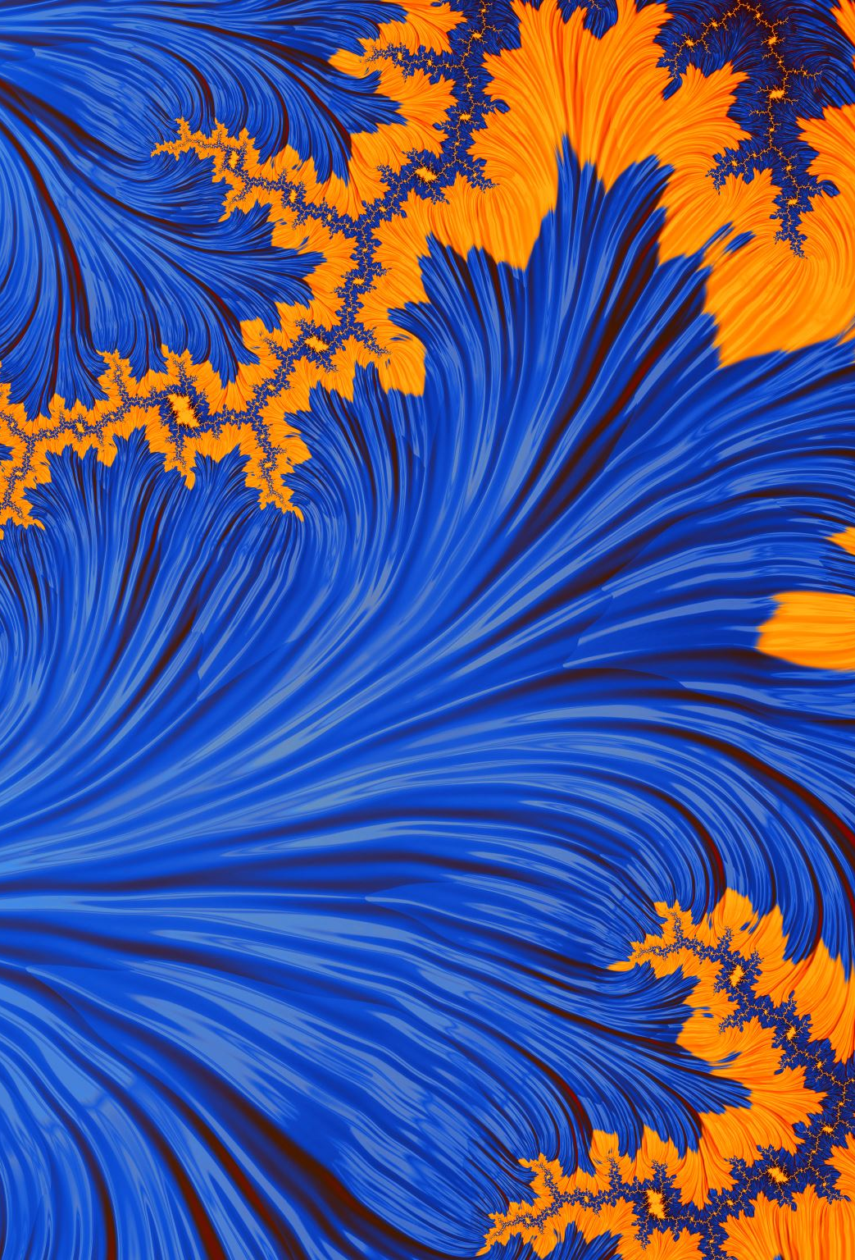
Computer Graphics
Week 10: Lighting, shading, and materials

Slide 2
Last week
We learned about textures
We learned how important they are to the realism of the scene
We learned how to implement them in OpenGL
We learned about different filtering techniques.

Slide 3
This week
We’re going to learn how to add lighting to our scene, specifically with the Phong illumination model
We’re also going to learn about materials: which are parameters that control how light hits our textures.

Slide 4
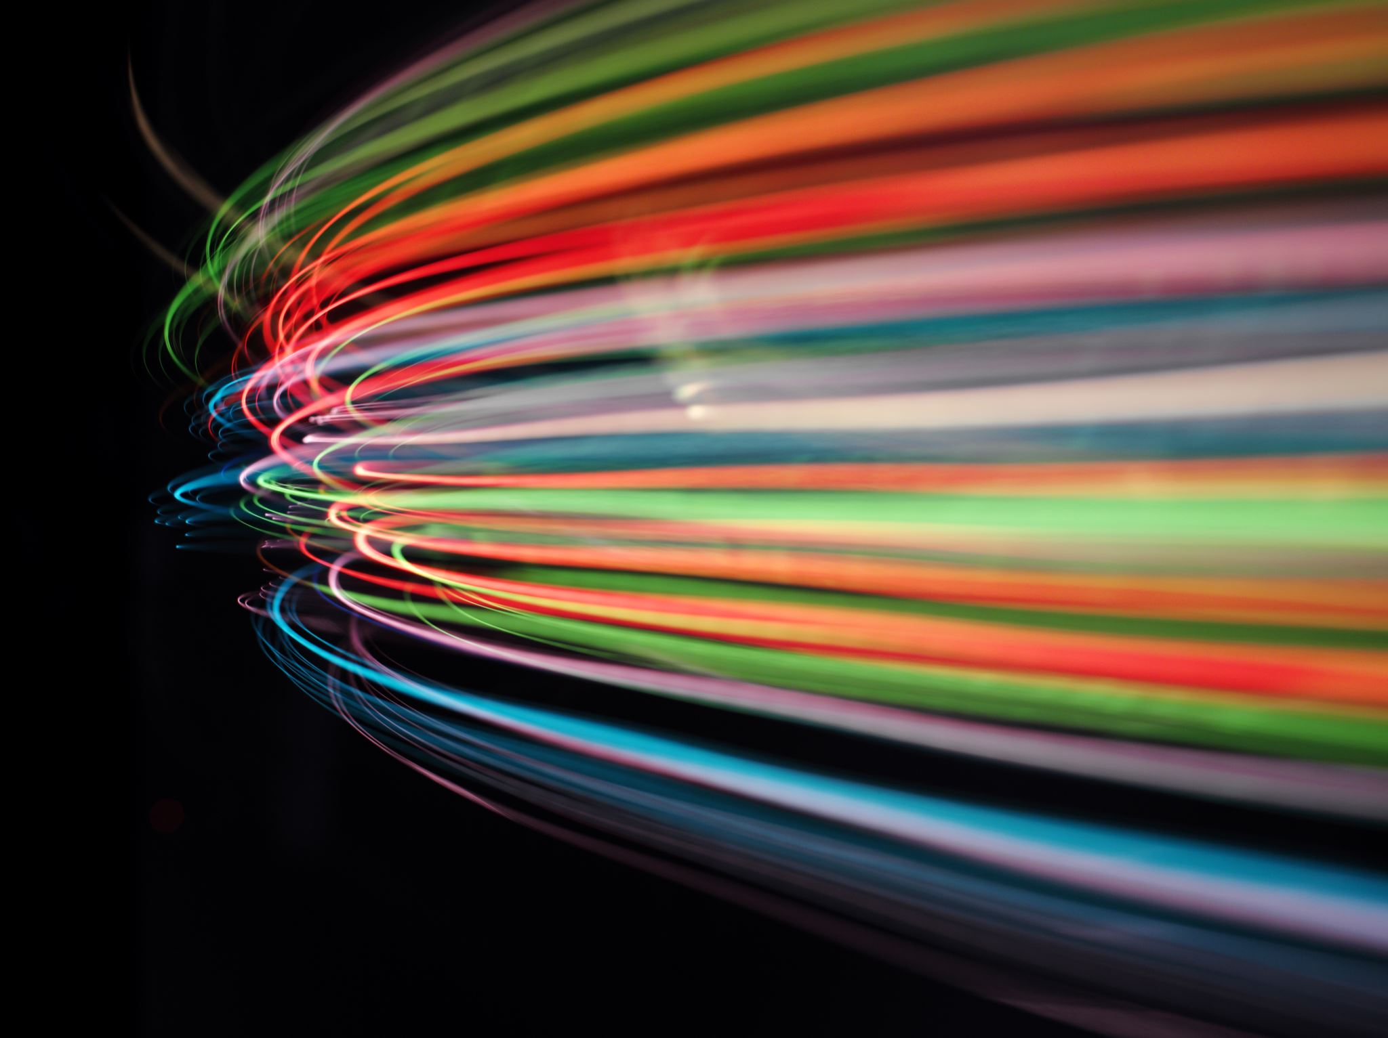
How do lights work?
A light is something that emits photons
Those photons enter the environment and bounce around until they hit someone’s eye or get absorbed into something else.
If they hit our eye, they impart some brightness and color.

Slide 5
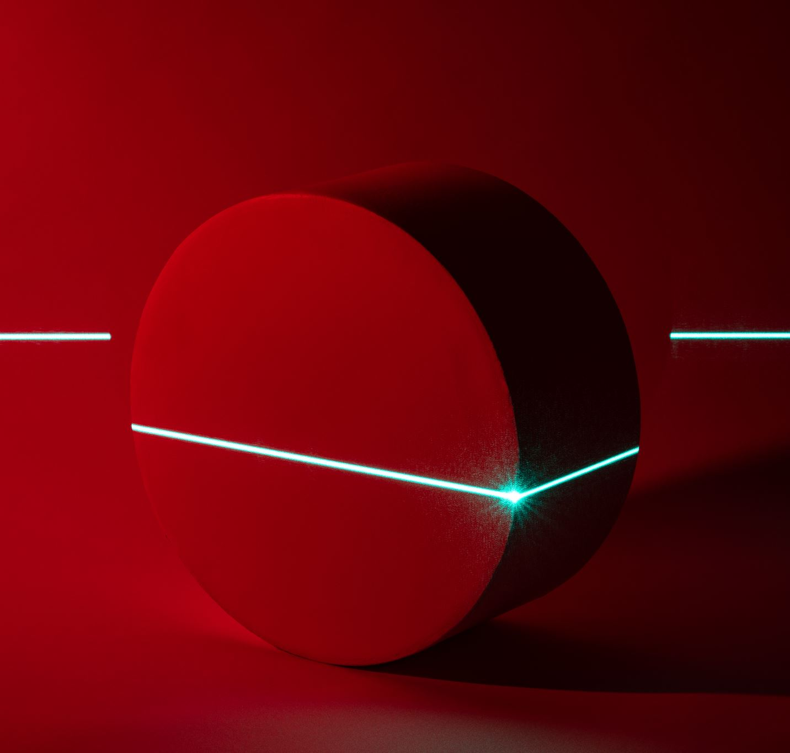
How do we simulate this?
Fundamental to the behavior of photons is that they reflect off the surfaces of objects.
This means, the amount of light redirected by a surface depends on its orientation.
How do we represent the direction that a surface faces in mathematics (or physics)?

Slide 6
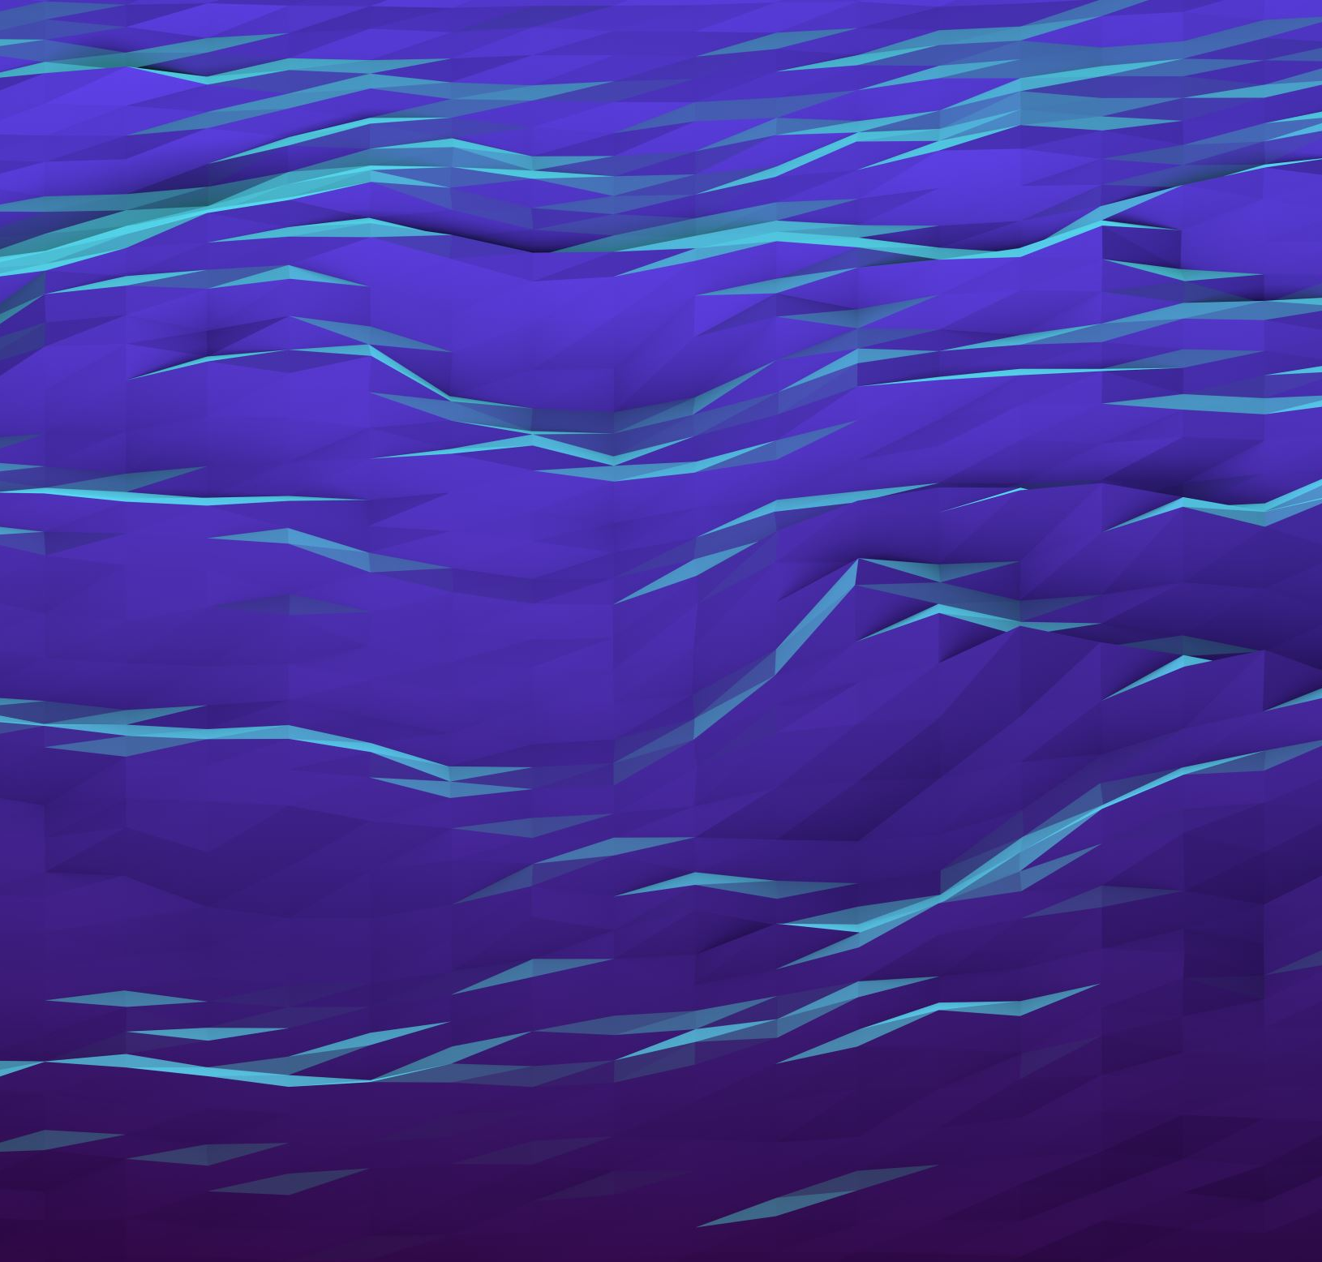
The surface normal
The surface normal is a vector pointing away from a surface
Specifically, it’s perpendicular to the surface, and if we were facing the surface head on, it would be pointing at us.
The normal gives us the information we need to determine how light is going to be reflected and diffused

Slide 7
Ray tracing
There is a technique we haven’t talked about that’s based around simulating the behavior of light programmatically.
It’s called “ray-tracing”
It works like this:
For each pixel, send out a virtual anti-light ray
Have that ray bounce around the scene
At each bounce, determine what lights are visible at that point

Slide 8
Ray tracing (2)
This technique can be extended to generate photo-realistic images
For instance, the refraction of light hitting water can be simulated by changing the direction the ray points when it enters water.
And the effects of lights bouncing off walls and other reflective surfaces can be simulated by casting more rays at intersection points.
This is extremely slow (the number of ray intersections in one, high-resolution image is immense), however, it can be trivially parallelized.

Slide 9
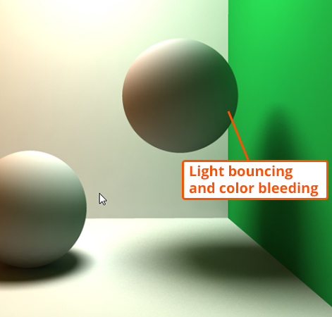
Global illumination
The main thing that separates photo-real images and those that are obviously computer generated is global illumination.
This means that every surface can cast light on every other surface.
It’s subtle, but notice the sphere to the right has some green color cast on it by the wall.
The kinds of lighting we are used to in the realtime-space is called “direct illumination”
More examples: https://en.wikipedia.org/wiki/Global_illumination
Image: https://www.pluralsight.com/blog/film-games/understanding-global-illumination

Slide 10
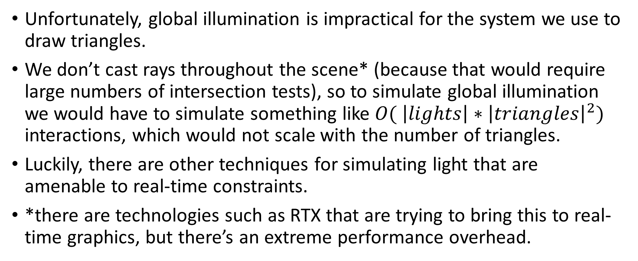
Real-time concerns
Unfortunately, global illumination is impractical for the system we use to draw triangles.
We don’t cast rays throughout the scene* (because that would require large numbers of intersection tests), so to simulate global illumination we would have to simulate something like $O( \left|lights\right|∗{\left|triangles\right|}^{2})$ interactions, which would not scale with the number of triangles.
Luckily, there are other techniques for simulating light that are amenable to real-time constraints.
*there are technologies such as RTX that are trying to bring this to real-time graphics, but there’s an extreme performance overhead.

Slide 11

Questions?

Slide 12
The Phong illumination model
A revolutionary approach to simulating fast lighting on the computer
Invented by researcher Bui Tuong Phong
The basic idea:
Break light into three components: diffuse, specular, ambient
Diffuse represents the light scattered by a surface (because of roughness)
Specular represents the light reflected by the surface into your eyes
Ambient is a constant that simulates global illumination
We treat our triangles as “smoothish” surfaces that reflect light, and ignore the effects of triangles on each other (using the ambient term to roughly simulate that)

Slide 13
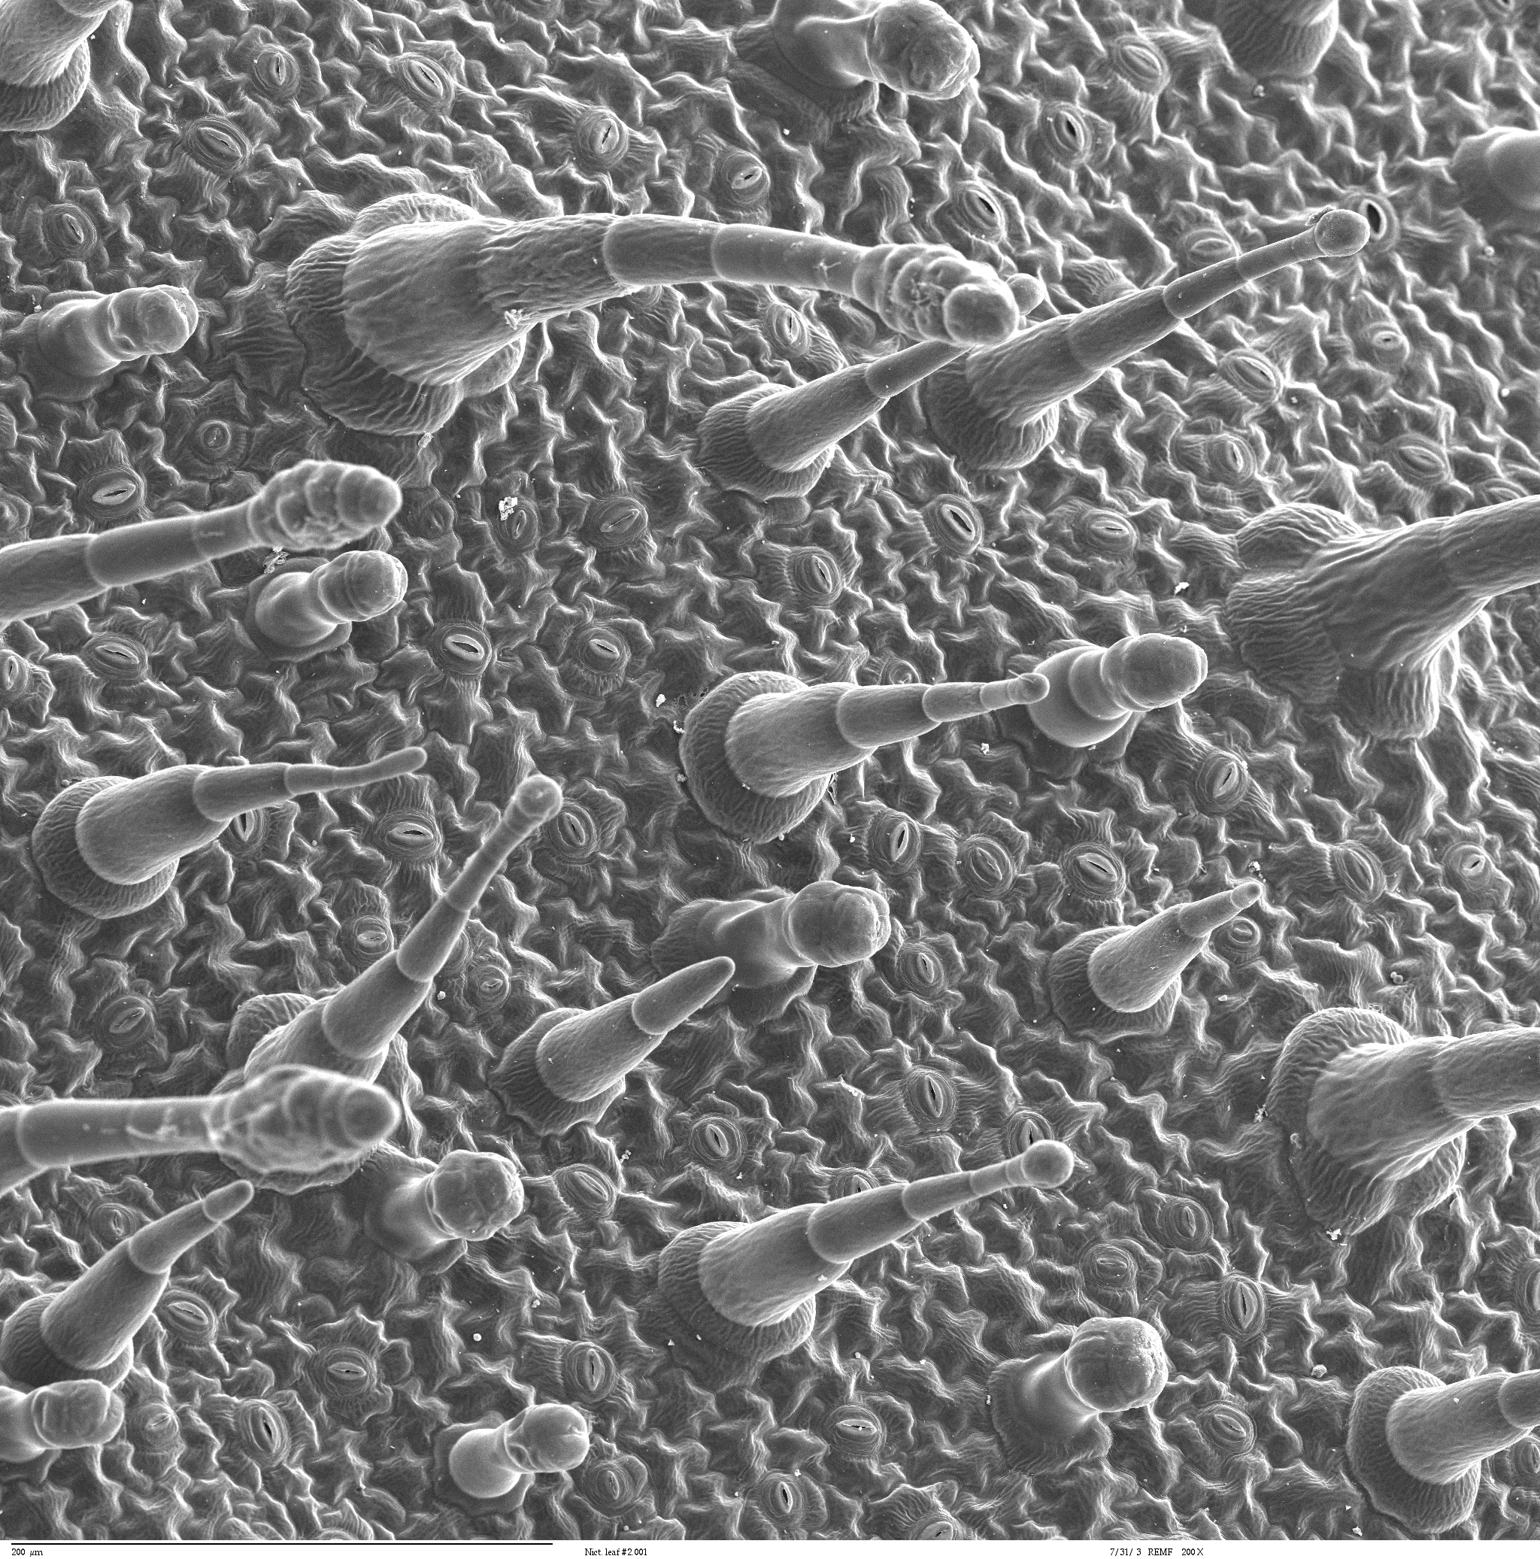
Surface
If we zoom in on a so-called smooth surface, we’ll realize it’s not very smooth at all.
These rough textures cause light to be scattered (diffuse)
The light that isn’t scattered is reflected or absorbed
The image right is from a leaf.
Louisa Howard (Dartmouth electron microscope facility) https://en.wikipedia.org/wiki/File:Leaf_epidermis.jpg

Slide 14

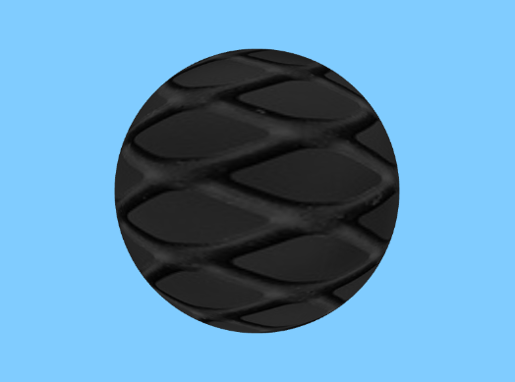
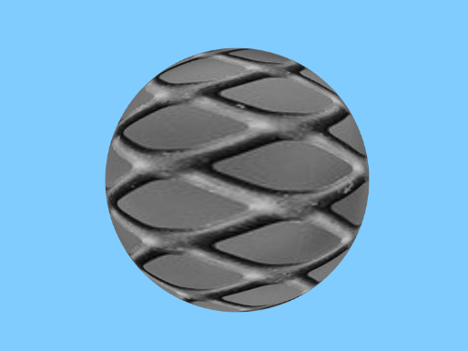
Ambient light
The ambient component of light determines how much light is scattered into the scene on all triangles.
It’s a very simple way of raising the “base brightness” of a scene
Ambient = 0
Ambient = 25%
Ambient = 75%

Slide 15
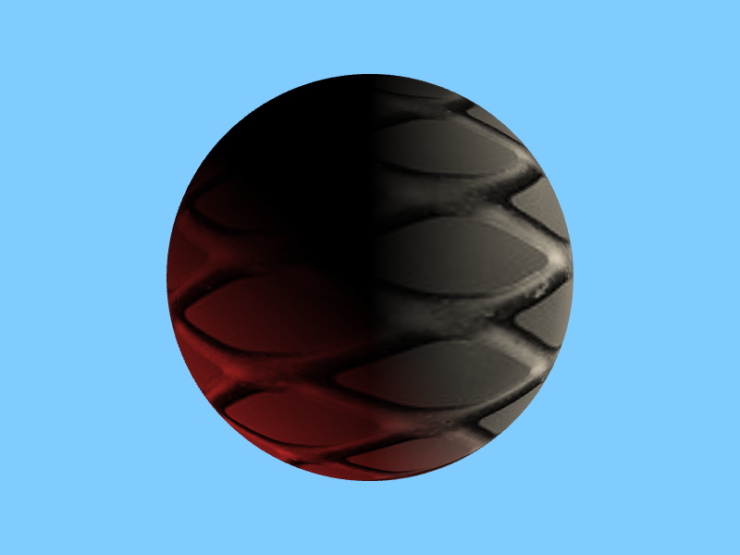
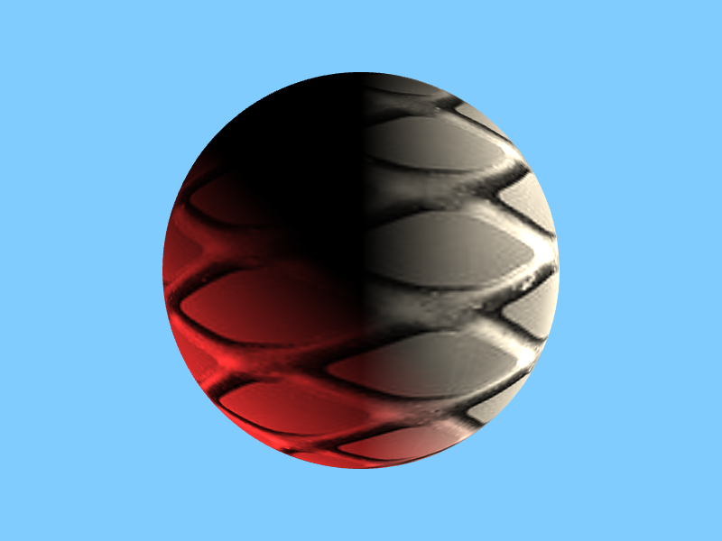
Diffuse Light
Diffuse light represents light that is scattered evenly because of the roughness of a surface.
It is determined based on the angle between the surface normal and light
How do you think this would be calculated?
Diffuse = 0
Diffuse = 50%
Diffuse = 100%

Slide 16

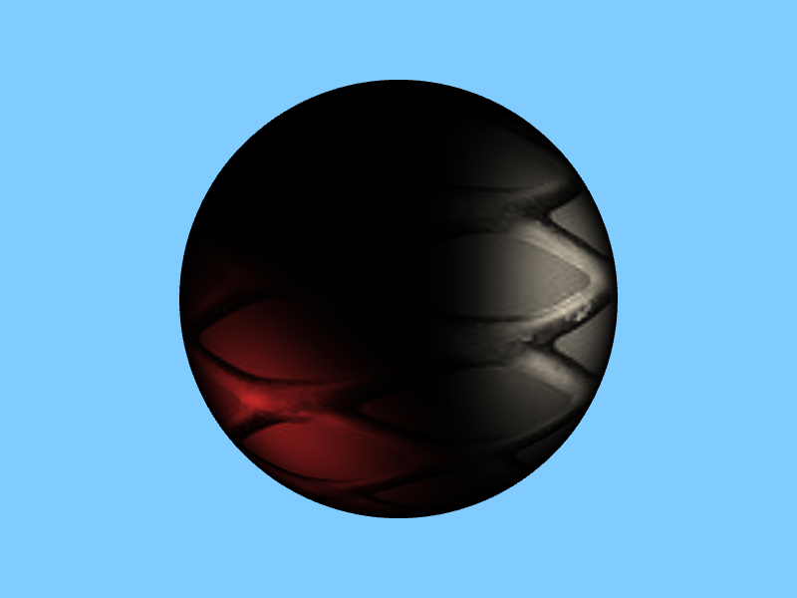
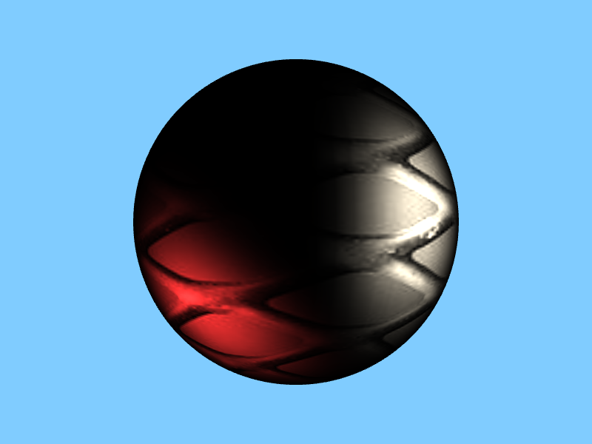
Specular light
Specular light represents light bouncing off the surface to the camera
The surface needs to be at least somewhat smooth for this to happen
This calculation is more complex. Any ideas?
Specular = 0
Specular = 50%
Specular = 100%

Slide 17
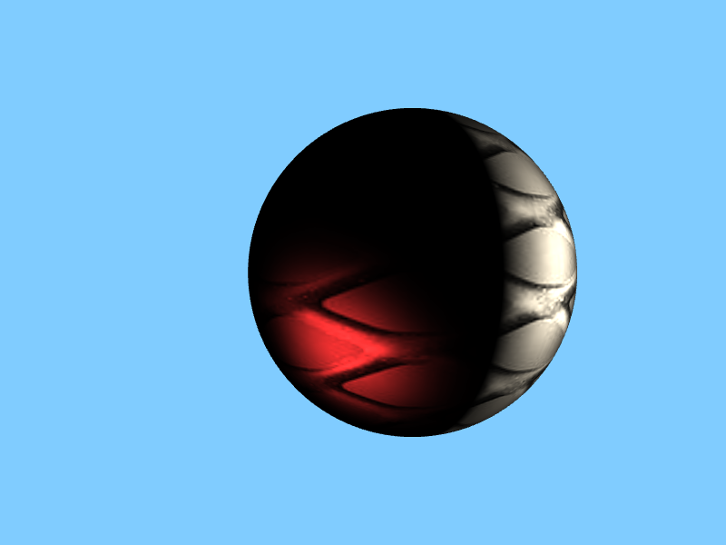
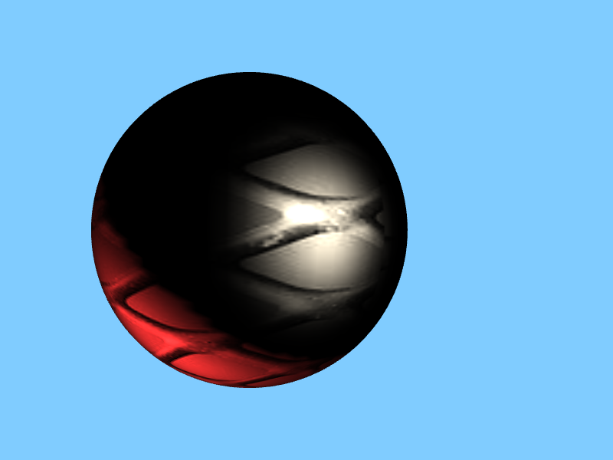
Specular light (2)
The area where we see the light reflecting is called the “highlight”
It moves as we move our camera.

Slide 18
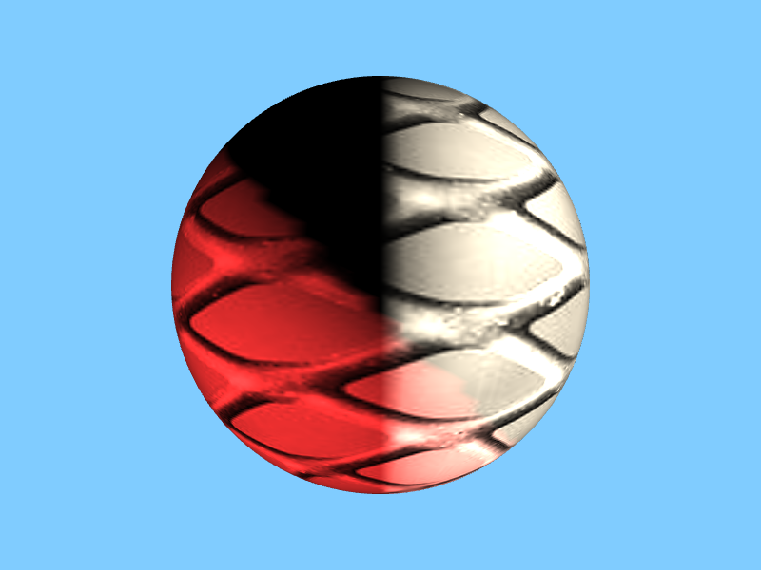
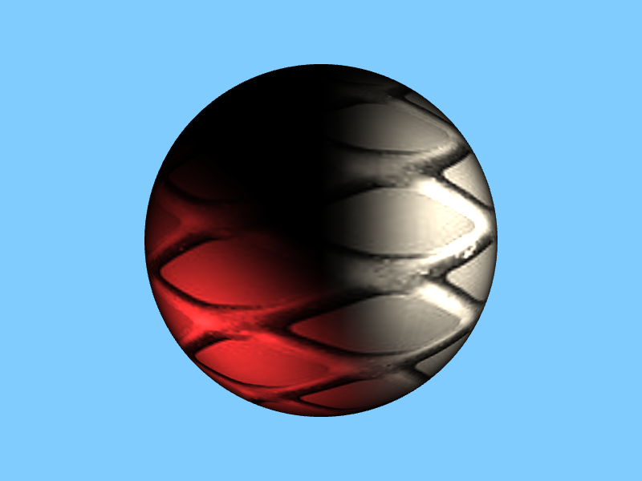
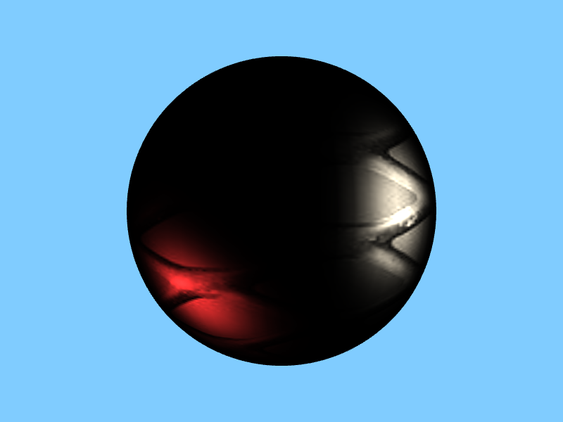
Specular light shininess
It also varies with the “shininess” of the surface (more shiny surfaces have smaller highlights
Shininess = 0.1
Shininess = 3
Shininess = 9

Slide 19
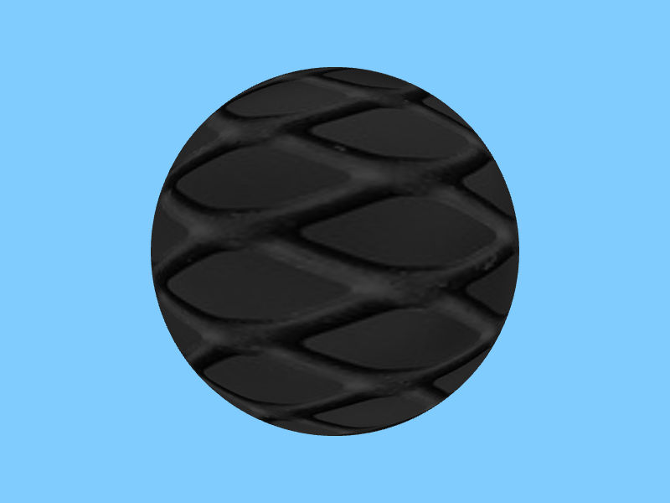
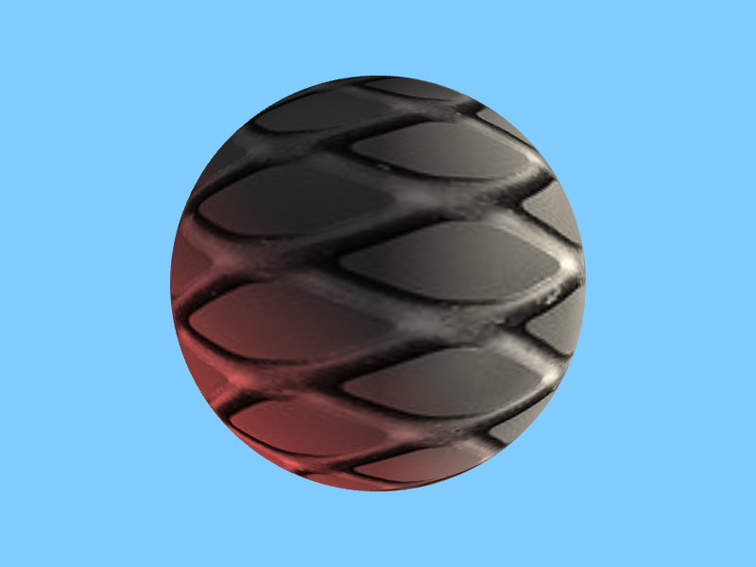
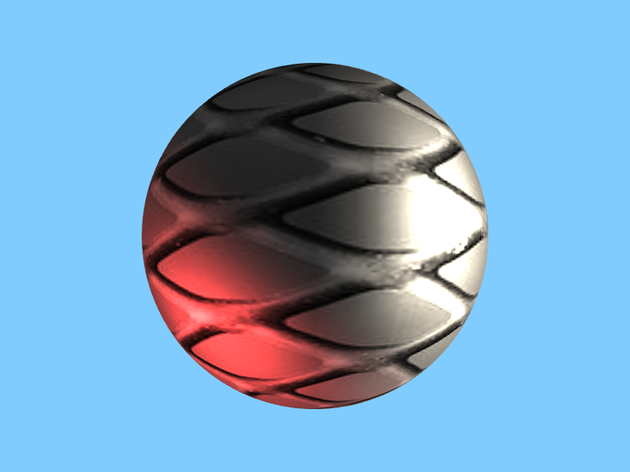
Phong is additive
Each of these components is added to one another to produce the final image.
Only ambient
Ambient + diffuse
Ambient + diffuse + specular

Slide 20
Where do these parameters go?
We’ve learned about 4 parameters:
Ambient
Diffuse
Specular
Shininess
You might think they should belong to the light. That is, we have specular lights and diffuse lights, etc.
The only property that lights have is location and color (which also includes brightness).
In reality, the parameters belong to the surface. Some surfaces are more diffuse than others, some are more specular, etc.
The behavior of a surface relative to light is called a “material”

Slide 21
Materials
Materials are normally associated with textures
That is, a material has a texture, along with defining those different light parameters we just discussed
In order to use a material, we bind the texture, and set uniforms in our shader corresponding to the different phong parameters

Slide 22

Questions?

Slide 23
Where does Phong happen?
Phong is an illumination model, which means a way of describing how light defines the colors we see of a scene.
What we want is a shading system. A way of applying the illumination model in our shaders.
But where in the shaders?
We can apply Phong lighting in our vertex shader. This is called Gouraud (“goo-row”) shading after Henri Gouraud.
We can also apply Phong lighting in the pixel shader, which is just called Phong Shading

Slide 24
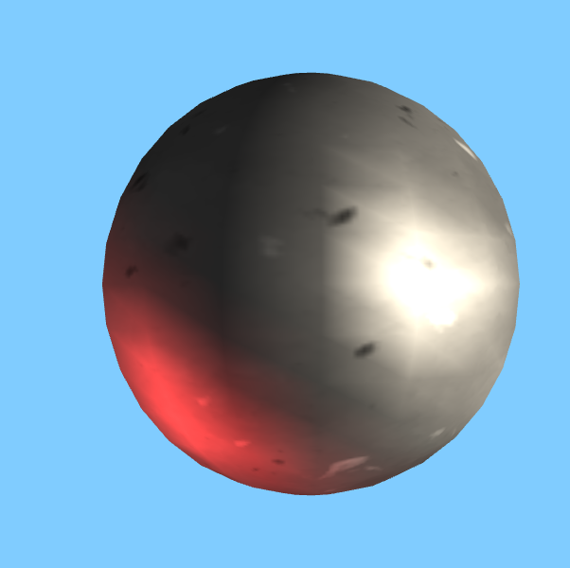
Gouraud shading
Gouraud shading was a key optimization that made the Phong model easy to apply in 5th generation game systems.
In it, we calculate the 3 components of the Phong model for each vertex, and the fragment shader just takes these colors and interpolates them (all the work is in the vertex shader).
When the model is low-poly, it looks a little rough, but it is usually much faster than Phong shading.
You can see the interpolation, which often shows the polygons of the underlying model

Slide 25
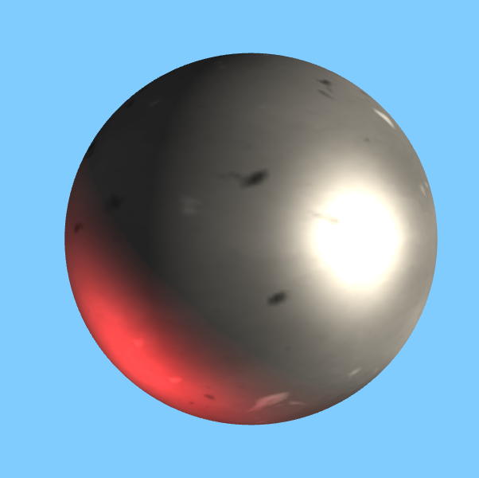
Phong Shading
In Phong shading, the calculations are identical to Gouraud shading, but we apply them in the pixel/fragment shader
Basically, Gouraud shading is per-vertex, while Phong shading is per-pixel.
The tradeoff is performance vs. visual quality
With high-poly enough meshes, you can’t tell the difference.

Slide 26
Which one should I use?
For your projects, feel free to go either way.
Phong shading looks a bit nicer, but Gouraud has that retro appeal.
But in order to use either one, we have a bit of work to do.

Slide 27
Normals
The most important thing we need to add to have proper lighting are vertex normals
Our vertices already have position, color, and uv coordinates. Now they will have normal vectors assigned to them.
Yes, it’s strange that we associate normals with vertices instead of with faces. This is a by-product of how the graphics pipeline works.
On smooth meshes this doesn’t matter. On boxy ones it does, which is why our boxes need to have extra vertices. They need this for UV coordinates, too.
Let’s generate a mesh with easy to define normals…

Slide 28
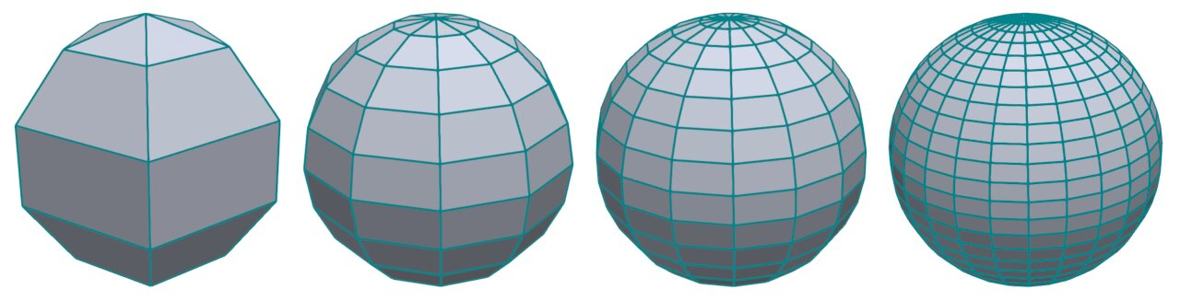
The UV sphere
One of the simplest and most useful meshes for testing the behavior of light is the UV sphere.
The UV sphere is made by generating concentric circles and connecting them with strips of triangles.
I’ll give the basic algorithm in class and ask you to follow it for your project.
Image credit: Daniel Sieger, https://www.danielsieger.com/blog/2021/03/27/generating-spheres.html

Slide 29
Questions?

Slide 30
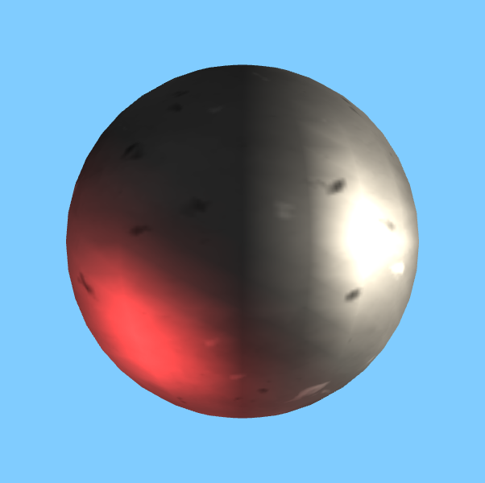
Generating a UV sphere
First, we have to decide how many subdivisions we want
The more subdivisions, the more like a sphere the result will look. A small number of subdivisions will make it look more like a chunky rock.
Now, let’s define the vertices and indices for our mesh.
20 subdivisions

Slide 31
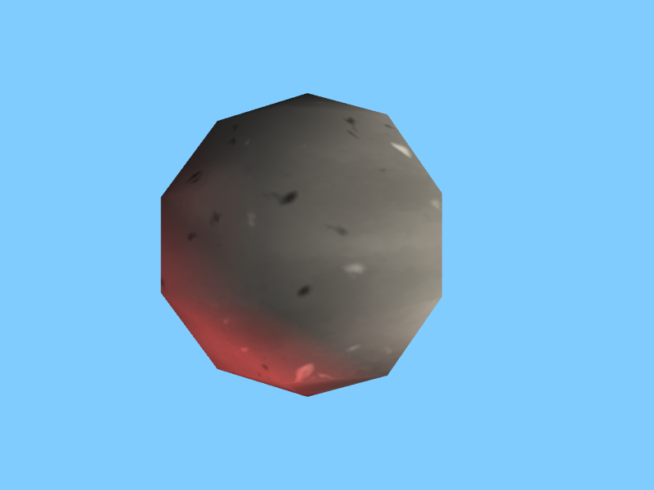
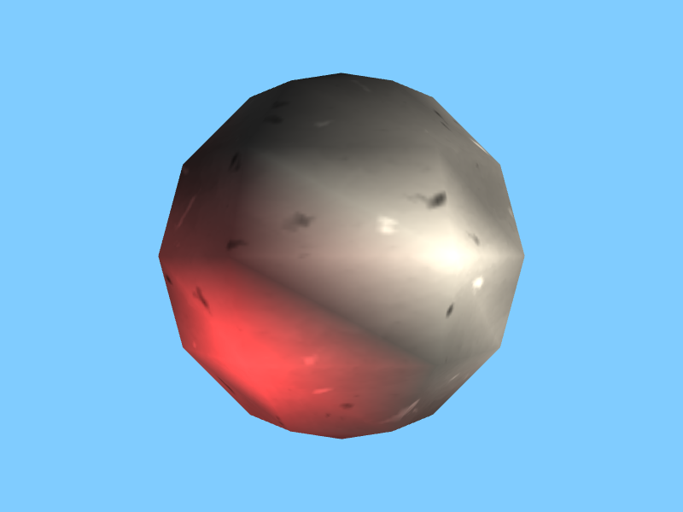
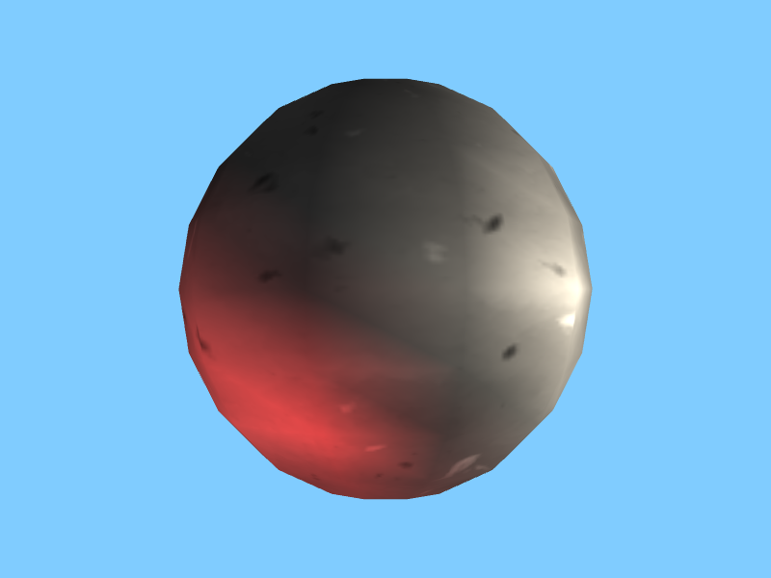
UV sphere: increasing the subdivisions
5 subdivisions
6 subdivisions
10 subdivisions

Slide 32
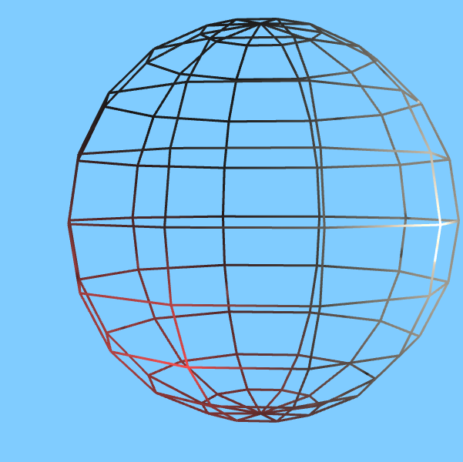
Wireframe example
The subdivisions are basically strips/ribbons.
Each one goes around the surface of the sphere as a ring.
If we plot the vertices correctly, the rings will form a sphere.
We stitch the rings together so that the sphere is solid.
One ring is highlighted. We need to make a bunch of these.

Slide 33
Generating a UV sphere (2)
Let’s wrap this in a function: function make_uv_sphere( gl, program, subdivs, material ) {
Just like our meshes before, we’re going to start with a vertex array and an index array: let verts = []; let indis = [];
Now, we’re going to break our sphere into layers, and iterate over each one. Within each later, we will build a circle.
Let’s continue.

Slide 34
Generating a UV sphere (3)
The UV sphere is broken down into layers, each of which is a circular cross-section of the sphere, starting at the south pole and working up.
The height of each layer is not linear, otherwise we would make a tapered cylinder. We have to “circularize” it so that layers actually follow the surface of a sphere: // for each layer let y_turns = layer / subdivs / 2; let y = Math.cos( y_turns * TAU ) / 2;
(we use cos instead of sin because we want our maximum value at 0—the top)
This is the y-coordinate of the layer’s vertices
XY PLANE (notice the vertical distances between vertices are not constant)

Slide 35
Why?
Y=.5
Y=cos(1/16*tau)/2
Here are some y-values plotted.
To draw a ring, you need 2 y-values.
All of your vertices will be split between the 2 y-values.
So the first step is figuring what the y-values are for each ring.
The formula we just saw tells us that.
Now, we need the x and z values.
XY PLANE
Y=cos(2/16*tau)/2
Y=cos(3/16*tau)/2
Y=0

Slide 36
Generating a UV sphere (4)
Now, we have a nested for-loop for each vertex within the layer circle: for( let subdiv = 0; subdiv <= subdivs; subdiv++ ) {
We can calculate the angle of the vertex we’re currently computing: let turns = subdiv / subdivs; let rads = turns * TAU;
Now, we can calculate the x and z values (we already have y): let x = Math.cos( rads ) / 2 * radius_scale; //we'll see this in a second let z = Math.sin( rads ) / 2 * radius_scale;
Then, add the x, y, and z to your vertex array: verts.push( x, y, z ); // don’t forget to add other components too, like colors, UVs, and normals.

Slide 37
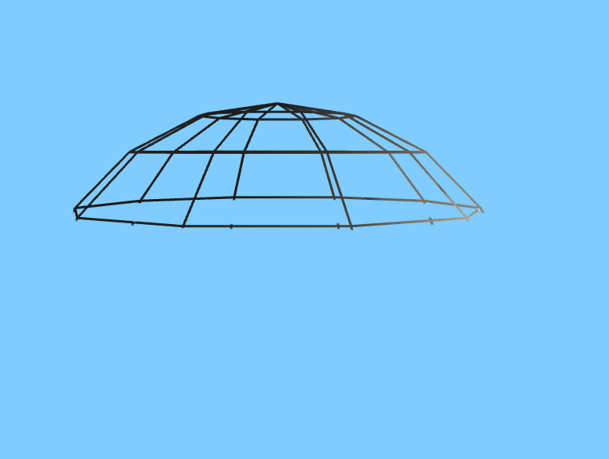
After 2 "rings" plus the top

Slide 38
Finding XZ values
We can treat the XZ plane as just like the XY plane, except Y is replaced with Z.
We already know the Y.
So for each point in a ring going around a single, fixed Y, we do this calculation: let x = Math.cos( 2*pi*turns ) / 2 * rs; let z = Math.sin( 2*pi*turns ) / 2 * rs;
Rs = radius scale. The rings get wider as we approach the middle of the sphere.
And turns is the vertical strip divided by the number of vertical strips. In this case, 10.
X = cos(2*pi*2/10) / 2 * rs Z = sin(2*pi*2/10) / 2 * rs
X = cos(0) / 2 * rs = ½ * rs Z = sin(0) / 2 * rs = 0

Slide 39
Generating a UV sphere (4)
The color can be whatever you want it to be. I’ll make mine white: verts.push( 1, 1, 1, 1 );
The UVs are calculated as follows:
The U is subdiv / subdivs. Therefore it will range from 0 to 1 (because our for loop is <= subdivs)
The V is the layer / subdivs.
This is basically the Mercator projection
Add them to the vertex array, too: verts.push( u, v );

Slide 40
How do I get the normal?
The normal
The normal, points away from the surface of the sphere.
The vector from the radius to the point on the surface, is pointing in the same direction as the normal.
However, it might be the wrong length.
Just normalize it. We want normals to have a magnitude of 1.
CENTER

Slide 41
Radius scale
At 0 turns from the top, we want the radius of the ring to be 0.
At a quarter turn from the top, we want the widest radius.
And at a half turn, we want to reach the bottom, where the radius is 0 again.
What function has this behavior?

Slide 42
Radius scale (2)
Turns = 0 rs = sin(0) = 0
Turns = 1/8 rs = sin(tau*1/8)
Squeeze by a little less than 1/2
This is the sine function. Take the sine of the number of turns we are away from the top.
y_turns = layer / 10 / 2 rs = sin( 2 * Math.PI * y_turns );
The dotted line shows how we compute our angle. It's a verticle angle to a point on the edge of the ring.
Turns = ¼ rs = sin(tau*¼)=1
Multiply radius by 1: don't squeeze.
Turns = 0 rs = sin(0) = 0

Slide 43
Generating a UV sphere (5)
Lastly, we have to add the normals.
How do we calculate the normal of a point on the sphere?
We know the x, y, z, coordinates, and the sphere has an origin of (0, 0, 0)
I will leave this up to you, but I think we can figure it out now.

Slide 44
Indices
I won’t tell you how to generate indices.
Your job is to find a way to stitch the layers together.
You’ll need to start after the 0th layer, so you’ll be stitching the 0th and 1st layers together, the 1st and 2nd, etc.
You can either use gl.TRIANGLES or gl.TRIANGLE_STRIP.

Slide 45
Problems with UV spheres
Notice that the UV sphere has an irregular distribution of vertices: they’re all crammed at the poles
This isn’t very efficient. It means we lose or gain detail depending on where on the sphere we are.
The other problem with them is that texture mapping is awkward: the equator distorts the texture, and the poles need to take up too much on the image relative to their surface area on the sphere.
We see this same problem in the Mercator projection, where Antarctica looks like the biggest continent: https://en.wikipedia.org/wiki/Mercator_projection#/media/File:Mercator_projection_Square.JPG

Slide 46
Problems with *this* UV sphere
Our UV sphere is not as efficient as it could be.
The top and bottom rings have a radius of zero, so we could make them be a single point instead. This would add some complexity to the mesh generation function, but the resulting mesh would have fewer triangles for the same visual effect.
We could use triangle strips instead of triangle lists for each strip. Use the maximum index (65535 for short indices) to "restart" the triangle strip for the next ring: https://registry.khronos.org/webgl/specs/latest/2.0/#NO_PRIMITIVE_RESTART_FIXED_INDEX

Slide 47
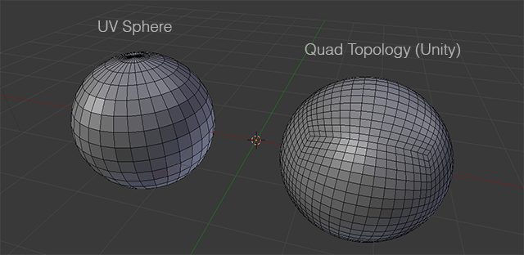
Other kinds of sphere
There are many ways of meshing a sphere, but one of the best alternatives is the quad sphere, which we get by subdividing a box and bending each face’s vertices.
The benefits here is that it’s easy to texture: we can use a 6-sided texture map like we did with the box earlier, and the UVs are very easy to calculate.
The only downside is some slightly odd topology around the seams of the 6 faces.
Image: https://answers.unity.com/questions/1441500/sphere-uv-distortion.html

Slide 48
Questions?

Slide 49
Let’s make a material now
Materials have the following properties:
An ambient component
A diffuse component
A specular component
A shininess
A texture
Note: these components normally range between 0 and 1, but there’s no requirement that they have to. You can make really bright highlights if you go past that range.

Slide 50
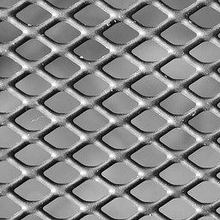
Metal scale:
Ambient: 25%
Diffuse: 100%
Specular: 200%
Shininess: 4
metal_scale.jpg from: public domain images (no author listed)
https://pixabay.com/photos/abstract-backdrop-background-gray-83802/

Slide 51
Sending material data to the shader
The material data is stored as uniforms in the shader.
We can bind the texture and set one uniform for each parameter: gl.bindTexture( gl.TEXTURE_2D, this.tex ); set_uniform_scalar( gl, program, 'mat_ambient', this.ambient ); set_uniform_scalar( gl, program, 'mat_diffuse', this.diffuse ); set_uniform_scalar( gl, program, 'mat_specular', this.specular ); set_uniform_scalar( gl, program, 'mat_shininess', this.shininess );
I’m using a class to store my materials, which is why you see a “this.”

Slide 52
Adding this data to the shader
It goes in the vertex shader if doing Gouraud shading, the fragment shader if doing Phong shading: uniform float mat_ambient; uniform float mat_diffuse; uniform float mat_specular; uniform float mat_shininess;
While we’re here, let’s add two more uniforms for the sun: uniform vec3 sun_dir; uniform vec3 sun_color;
I’ll leave setting these to you.
sun_dir is the direction to the sun, not the direction the sun is shining.

Slide 53
What’s the color?
We added a vec3 called sun_color as a uniform.
Colors are vectors too?
They are. GLSL let’s us refer to their components by rgb instead of xyz.
r is a synonym for x, y for g, z for b, and a for w.
So when setting color uniforms, just send a vector.
I’m using floats that represent the 3 lighting components of the material. However, you can use vectors instead to make the material react differently in different color channels (e.g., blue highlights but green ambient glow)

Slide 54
Point lights vs directional lights
Point lights represent a light that has a position in 3D space
Directional lights represent a light that has a direction but no position. We use this for lights that are so far away that they cast light on everything in the scene equally, so don’t need to determine a vector to them for each vertex.
Directional lights are simpler, so let’s simulate a classic directional light: the sun

Slide 55
Calculating lights
To keep it simple, let’s do Gouraud shading.
In the vertex shader, we have to do the following:
Calculate the ambient color of the vertex based on the material
Calculate the diffuse color of the vertex based on the material, the normal of the surface, and the direction to the light source.
Calculate the specular color of the vertex based on the material, the normal of the surface, the direction to the light source, and the direction to the camera
Let’s start with the easiest one.

Slide 56
The easy part: ambient
We take the 3 lighting components and add them together to get the final color (plus additional components for more lights): v_color = ambient_color + sun_diffuse + sun_specular + … ;
The ambient color is a constant, created from the material’s ambient: vec4 ambient_color = vec4( mat_ambient, mat_ambient, mat_ambient, 1.0 );
For more complex scenes, we probably would want ambient light to be associated with rooms or the level as a whole, and it would multiply the ambient component of the material. We’re taking a shortcut here.

Slide 57
Questions?

Slide 58
Let’s learn about diffuse lighting now
Diffuse lighting is scattered evenly in all directions because of roughness in the material.
Therefore, it doesn’t matter which direction we’re viewing it from, the only thing that matters is how “head on” the light is
We have 2 vectors: the vertex’s normal, and the vector that points to the light.
What easy-to-calculate function do we know that will tell us how much these two vectors are in alignment, thereby letting us know how “head-on” the light is to the surface?

Slide 59
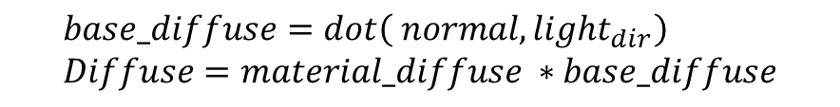
Diffuse normal example
$$base_diffuse=dot\left( normal, light_{dir}\right) \\ Diffuse=material_diffuse ∗base_diffuse$$
Normal
Direction to light

Slide 60
Using normals
The diffuse depends entirely on the normal and the direction to the light.
Both of these vectors must be normalized, otherwise the calculation will be messed up [what will happen?]
The normal must be transformed according to the model matrix. If we rotate the model, the normals must rotate too.
However, if we translate the model, we have to ignore the transformation.
Easy way to do this: take the model matrix and cast it to a 3x3 matrix before transforming the normal with it. This cuts off the w component entirely and makes it a pure translation/scale/rotation matrix: vec3 normal_tx = normalize( mat3( model ) * surf_normal );

Slide 61
Using functions
So far, the only function we’ve had in our GLSL programs has been “main”
Now that we’re doing lighting, it can be useful to wrap each component in a function to make the code a bit easier to read, and let us reuse it for different kinds of lights.
Here’s a function for the diffuse color: vec3 diff_color( vec3 normal, vec3 light_dir, vec3 light_color, float mat_diffuse ) { return mat_diffuse * light_color * max( dot( normal, light_dir ), 0.0 ); }
The max is so that we don’t end up with “negative light” if the normal faces away.

Slide 62
Adding specular
Specular is similar to diffuse in that it depends on the dot product between the normal and the light
However, it also depends on the direction to the viewer’s eye
This direction is calculated based on the model’s transformed coordinate (multiplied by the model matrix) and the camera’s position: vec3 coords_tx = ( model * vec4( coordinates, 1.0 ) ).xyz;

Slide 63
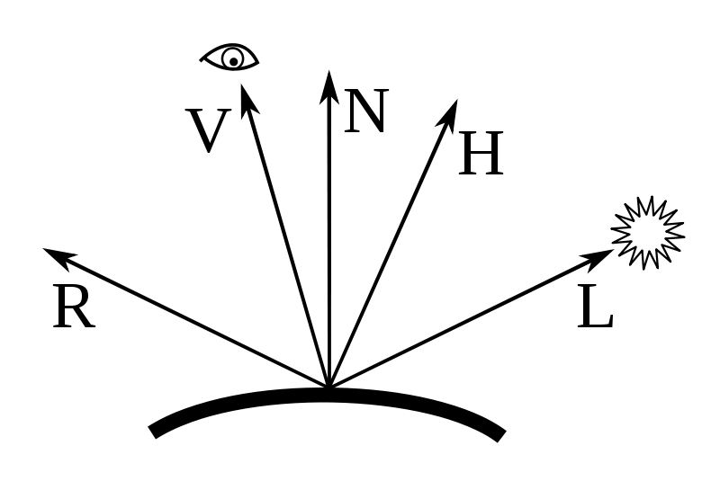
How specular works
N = the surface normal
L = vector pointing to light source
R = reflection of L over N
V = vector pointing to camera
H (we can ignore this one)
Image: Author: Martin Kraus, License: CC0, https://en.wikipedia.org/wiki/File:Blinn_Vectors.svg

Slide 64
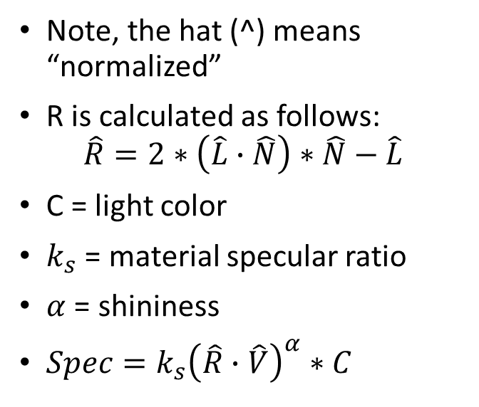


How specular works (2)
$$−L$$
Note, the hat (^) means “normalized”
R is calculated as follows: $\hat{R}=2∗\left(\hat{L}∙\hat{N}\right)∗\hat{N}−\hat{L}$
C = light color
$k_{s}$ = material specular ratio
$α$ = shininess
$Spec=k_{s}{\left(\hat{R}∙\hat{V}\right)}^{α}∗C$
$$L∙N$$
Image: Author: Martin Kraus, License: CC0, https://en.wikipedia.org/wiki/File:Blinn_Vectors.svg

Slide 65
Specular notes
I will leave you to implement these equations in GLSL
Just remember that specular is zero if the normal is pointing away from the light: float cos_light_surf_normal = dot( normal, light_dir ); if( cos_light_surf_normal <= 0.0 ) { return vec3( 0.0, 0.0, 0.0 ); }
Also, make sure that the result is at least zero. You’ll need to use “max” to ensure that this is the case.

Slide 66
Shininess
Shininess is an exponent on a dot product
The dot product is between two normalized vectors: therefore between 0 and 1.
Raising a number between 0 and 1 to a power above 1 will make it smaller.
Therefore: this term makes the spotlight smaller and makes the brightness much lower on the outside of the specular highlight.
If you want a material that is bright and shiny, you’ll need to increase both the specular and shininess components.

Slide 67
Questions?

Slide 68
What about point lights?
We just learned how to model the sun.
But ordinary lights are important too.
There are two differences to consider:
The direction: we take the transformed coordinates and subtract the coordinates of the light, then normalize that vector. With the sun we hard-coded its direction.
Attenuation: this means getting dimmer over space. The sun is so vast that it hits everything with the same brightness in our scene, but ordinary lights need to be close.

Slide 69
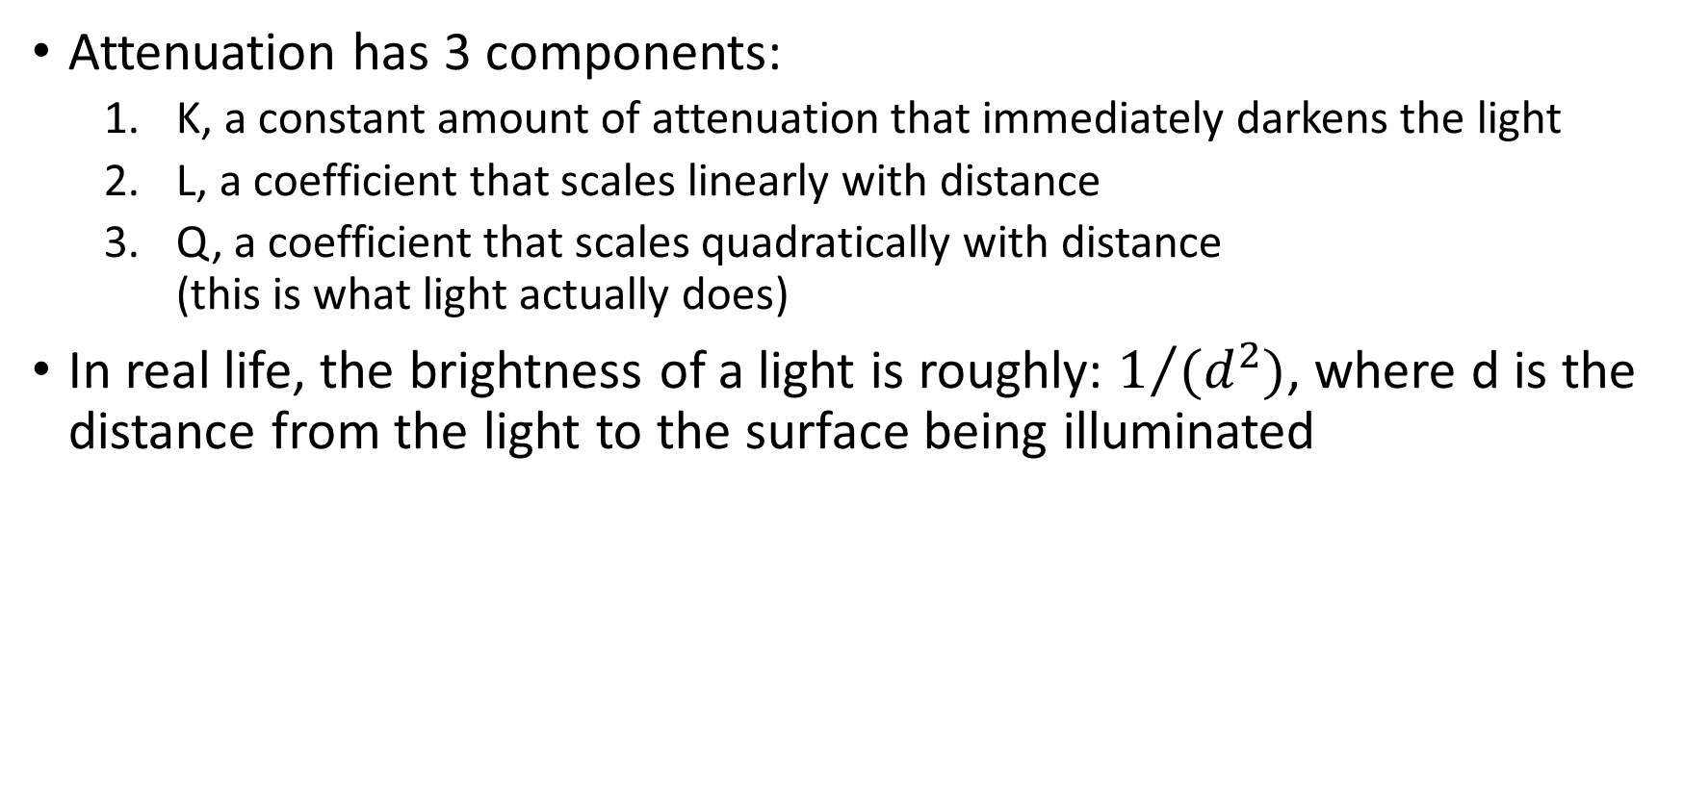
How do we calculate attenuation?
Attenuation has 3 components:
K, a constant amount of attenuation that immediately darkens the light
L, a coefficient that scales linearly with distance
Q, a coefficient that scales quadratically with distance (this is what light actually does)
In real life, the brightness of a light is roughly: $1/{(d^{2})}$, where d is the distance from the light to the surface being illuminated

Slide 70
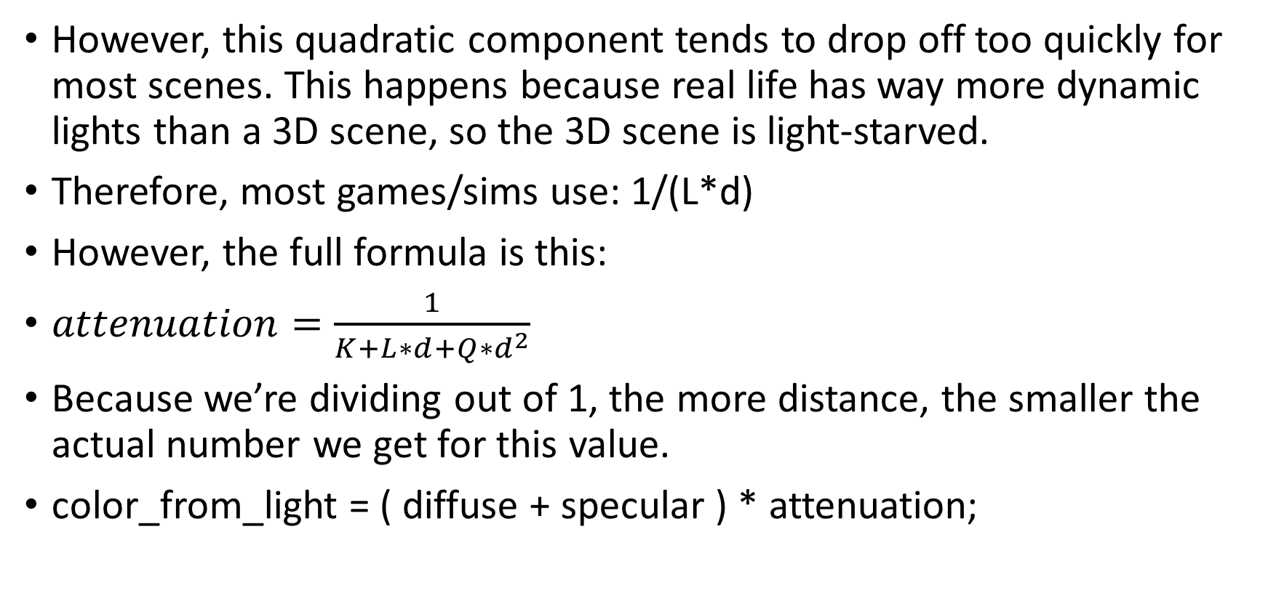
How do we calculate attenuation? (2)
However, this quadratic component tends to drop off too quickly for most scenes. This happens because real life has way more dynamic lights than a 3D scene, so the 3D scene is light-starved.
Therefore, most games/sims use: 1/(L*d)
However, the full formula is this:
$attenuation=\frac{1}{K+L∗d+Q∗d^{2}}$
Because we’re dividing out of 1, the more distance, the smaller the actual number we get for this value.
color_from_light = ( diffuse + specular ) * attenuation;

Slide 71
Lighting in practice
In reality, we typically have many dynamic lights active at a time.
It’s common to store them in an array in the shader
This lets us have a number of lights active without hardcoding color values for each one.
I’ll be doing this in my own program for the next assignment, which I will share.
Important consideration: each light adds a constant amount of time to process each vertex (or fragment for phong shading)
Sometimes the number of lights is configurable in graphics options.

Slide 72
Your assignment
Your goal is to do the following:
Have a scene with one UV sphere and two lights: one point and one directional.
Both lights must be a different color
The point light must have either linear or quadratic (or both) attenuation.
You can freely use tutorials, as long as you cite code you read and don’t pull more than 50% of their code. You can use as much of my code as you want.

Slide 73
Debugging suggestions
If you see a black screen, set the color in the fragment shader to a constant (like red). If you still see a black screen, the problem is with either your geometry or a matrix.
Disable back-face culling and re-enable it and compare. This lets you see problems with winding.
Implement the 3 lighting components one at a time. Set the others to zero in the material so you aren’t confused.
Set the outputs of each lighting component to vec4( 1.0, 1.0, 1.0, 1.0 ) to set them to white. If you aren’t seeing white, the problem is with the code outside the diffuse/specular calculation.
Check your matrix*vertex transformations very carefully.

Slide 74
Questions?

